Slide 1
Tuning Tips for DB2 LUW in an OLTP Environment
Philip K. Gunning
Gunning Technology Solutions, LLC
Session Code: C2
Date and Time of Presentation: Nov 5, 2012, 1:30 – 2:30 pm | Platform: DB2 for LUW
Notes:
NOTES: In this session you will learn how to quickly identify the cause of a problem using various DB2 snapshots, table functions, db2pd
and MONITOR report modules. Examples are provided of the various DB2 monitoring facilities available to use in identifying problem applications and associated SQL. Ways to identify lock holders and waiters will be discussed. This presentation discusses new monitoring infrastructure introduced in DB2 9.7 and enhanced in DB2 10.

Slide 2
Overview
Where is the problem? DB2 or OS?
Isolate the problem
  Where’s the bottleneck?
  CPU
  IO
  Memory
Check key metrics and parameters
Highlight key snapshots, table functions, db2pd output, and new MONREPORT reporting module
Notes:
NOTES: We all know that if there is a problem with an application or query, the first item that gets blamed is the database! You have to be able to quickly identify if the problem is with DB2 or if it is somewhere else. This presentation will help you to be able to do just that through a 5-minute fire fighting drill and through subsequent DB2 metrics and monitoring elements and discusses various ways to do it using DB2 provided monitoring facilities. New DB2 10 monitoring enhancements are discussed. This presentation should help you begin to transition from snapshot monitoring to the new monitoring architecture introduced in DB2 9.7 and enhanced in DB2 10.

Slide 3

Isolate the Problem with a Quick 5-minute Fire Fighting Drill
First step – Check the Graphs
Next, quickly take an application snapshot and database snapshot for later analysis
  This will capture state of database and all applications executing
  If it is a DB2 problem it will be associated with an EXECUTING application
Then immediately review last entry in db2diag.log
  VI, cat or tail, db2diag command or notepad
Quickly Review OS related metrics
  TOP, TOPAS, NMON, Windows Task Manager
  Review CPU usage of db2sysc process
Identify top process or application
  Is it DB2?
Notes:
NOTES: Upon the first report of a problem, immediately take an application snapshot and a database snapshot to capture state of the database and applications at time of report. You can do this manually, launch a script and use your favorite monitoring tool. You will need these snapshots for later analysis in your problem determination effort. You will learn that a DB2 application will be normally be in an executing or unit of work wait state. If it is in another state for any length of time, this is an indicator of a problem. Other states could be compiling, etc. Using the OS monitor relative to your environment, review the CPU usage of the db2sysc process, if it is high relative to normal operation and compared to other processes running or in the Top 10, investigate further by reviewing the db2diag.log and then application snapshot for applications in an Executing state.

Slide 4
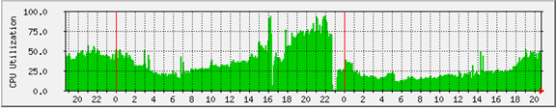
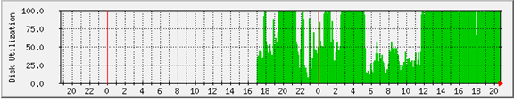
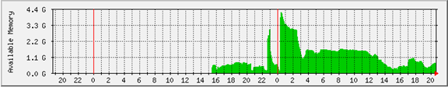
Quick Check of Key OS Resources
Notes:
NOTES: It is a best practice to graph OS related performance on a 24x7 basis. That way you can easily and quickly determine if there is an
OS related problem or possibly SQL driving high CPU or disk utilization. This is largely out of the control of the DBA but insist on the OS SYSADM or Network Administrator doing this. I have found continuous graphing of performance data very beneficial in helping to solve performance problems throughout my career. These particular graphs were generated by MRTG open software which uses an SNMP agent. Similarly, NMON and Ganglia (BSD-licensed open source) can provide the same data on AIX and Linux.

Slide 5
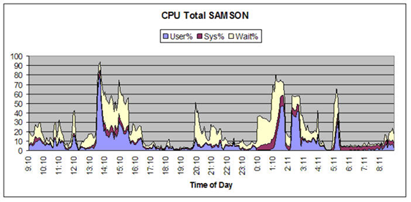
NMON Example - AIX
Notes:
NOTES: NMON is a tool developed by Nigel Griffith, IBM and is freely available for download at IBM developerWorks, http://www.ibm.com/developerworks. It’s features have been bundled within the AIX TOPAS command since AIX 5.3 TL09 thru AIX 6.1 TL02.

Slide 6
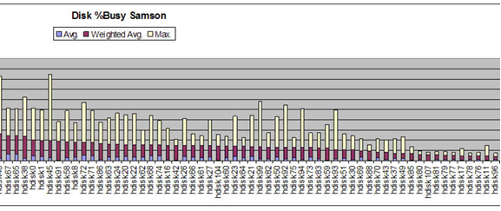
NMON Example, CONT.
Notes:
NOTES: The above graph was generated by NMON at a company with serious DB2 performance problems. At a glance a DBA can see
where the time is being spent. This helped convince managers of need to upgrade disk subsystem.

Slide 7
Quick Check of Key DB2 Potential Problem Areas
What will cause DB2 to hang or stop processing
  Archive Log filesystem full or problems with archive logging?
    Check the db2diag log for archive log failure
      DF command on UNIX or Linux
      Windows – Disk full?
Suboptimal query or queries doing scans in memory
  High number of logical index or table reads
SAN or Disk subsystem problems
  Controller issues, disks become unmapped, unmounted
Network Problem
  Ping the DB2 server and save timings
  Graph network performance
Notes:
NOTES: This is a brief list of a few problems that may cause DB2 to hang or stop processing.

Slide 8
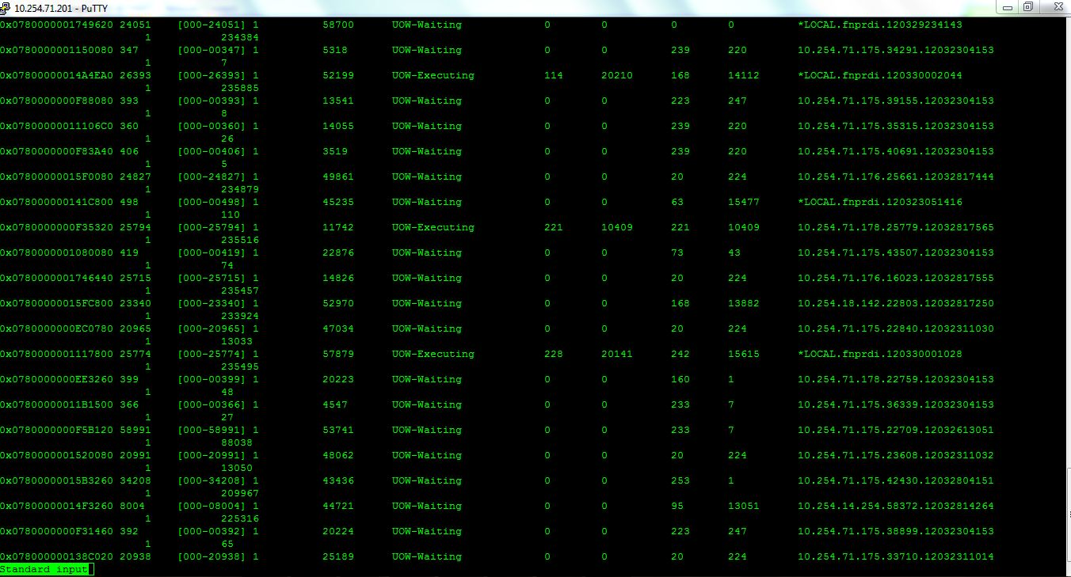
db2pd -d <dbname> -applications
Agent ID
Executing ID
Notes:
NOTES: You can use db2pd –d <dbname> -applications to list all applications and then focus in on ones that are Executing or UOW Waiting. In this case we are looking for applications executing and quickly find that that there are a few applications executing. An application snapshot on agentid 26393 did not reveal any problems, next we looked at agentid 25794 and saw some high resource usage that required further analysis. You can also use db2pd –edus interval=5 to identify DB2 agents with high USR and SYS CPU time.

Slide 9
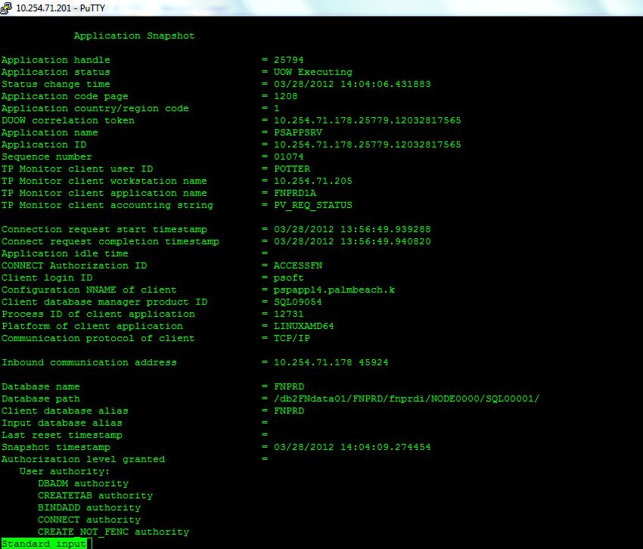
Tying db2pd –applications to Application Snapshot
Agent ID
Executing
Notes:
NOTES: Next we issues a “db2 get snapshot for application agentid 25794” application snapshot for further investigation.

Slide 10
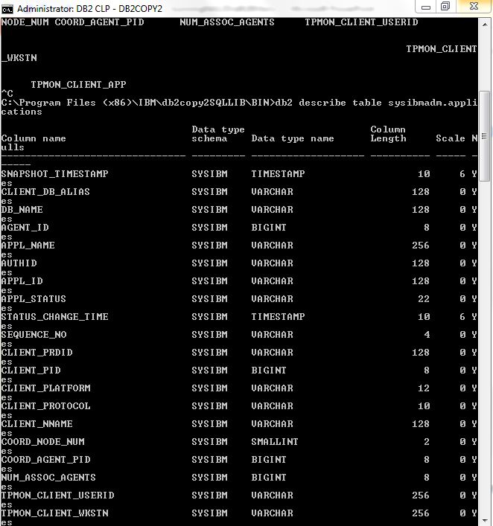
Application Information via Application SQL Administrative View in DB2 10
Agent ID
Executing?
Notes:
NOTES: We could have used the Applications administrative view to get some of the data that we obtained in the previous slide but it would not have provided everything that the application snapshot provided. We would need to use some additional snapshot table functions.

Slide 11
SQL Snapshot Table Functions
#!/bin/ksh
db2 connect to dsdm;
db2 "SELECT INTEGER(applsnap.agent_id) AS agent_id,
CAST(LEFT(applinfo.appl_name,10) AS CHAR(10)) AS appl_name,
CAST(left(client_nname,35) AS CHAR(35)) AS nname,
INTEGER(locks_held) AS locks,applsnap.rows_read as rr, applsnap.rows_written as rw,applsnap.total_sorts as sorts,
applsnap.sort_overflows as oflows, applsnap.lock_timeouts as touts, applsnap.total_hash_loops as loops, applsnap.agent_usr_cpu_time_s as usersecs,
applsnap.agent_sys_cpu_time_s as syscpu, applsnap.locks_waiting as lkwait,
SUBSTR(APPL_STATUS,1,10) AS APPL_STATUS, SUBSTR(stmt_snap.STMT_TEXT, 1, 999) AS STMT_TEXT
FROM TABLE( sysproc.snap_get_appl('',-1)) AS applsnap,
TABLE( sysproc.snap_get_appl_info('',-1)) as applinfo,
TABLE (sysproc.snap_get_stmt('',-1)) as stmt_snap
WHERE applinfo.agent_id = applsnap.agent_id
and applinfo.agent_id = stmt_snap.agent_id
and appl_status in ('UOWEXEC','LOCKWAIT')
ORDER BY appl_status";
db2 connect reset;
Notes:
NOTES: The three snapshot table functions combine to give us a complete picture of the state and status of an application. This is equivalent to “db2 get snapshot for applications on <dbname>” application snapshot. You could run this script from CRON and save each iteration to a file with the date/time appended to it for use in problem determination and for historical data.

Slide 12
Steps Taken
Step 1 – Determine if problem in DB2, if not, EXIT!
Step 2 – If in DB2, take database manager and database snapshot, application snapshot, (maybe lock snapshot) and use db2diag command or tail db2diag log
Step 3 – If db2diag.log does not contain errors then proceed to quick review of Instance and DB snapshots to see if thresholds breached
Step 4 – review applications in Executing state and determine which application is causing problem
  db2pd, application snapshot, SQL Administrative View, snapshot table functions, MONREPORT reporting module, db2top or other monitor
Notes:
NOTES: There are many different ways to get the data, use what works best for you.

Slide 13

Essential Application Elements to Examine
Look at applications in Executing and Lock-Wait status, one of these will be the cause of the problem
For applications in Executing status, look for the following:
  Total sorts = 35782
  Total sort time (ms) = 7097
  Total sort overflows = 218
  Buffer pool data logical reads = 1102578477
  Buffer pool data physical reads = 87171 CPU Burn!
  Buffer pool temporary data logical reads = 55264
  Buffer pool temporary data physical reads = 0
  Buffer pool data writes = 579
  Buffer pool index logical reads = 325915793
  Buffer pool index physical reads = 124802
  Buffer pool temporary index logical reads = 0
  Buffer pool temporary index physical reads = 0
Notes:
NOTES:

Slide 14
Essential Application Elements to Examine, cont.
For applications in Executing status, look for the following:
  Rows deleted = 57991
  Rows inserted = 350298
  Rows updated = 1185248
  Rows selected = 366993
  Rows read = 1106728657
  Rows written = 5009851
This application had to read 1 Billion rows to select 366,000! Indication of suboptimal SQL!
Notes:
NOTES: High ratio of rows selected to rows read is an indicator of suboptimal SQL, seek and tune the SQL. Think dynamic SQL snapshot, MONREPORT.PKGCACHE report or event monitor, if needed.

Slide 15
Essential Application Elements to Examine, cont.
Total User CPU Time used by agent (s) = 8402.923420
Total System CPU Time used by agent (s) = 35.695327
Host execution elapsed time = 8979.020210
Number of hash joins = 258
Number of hash loops = 0
Number of hash join overflows = 0
Number of small hash join overflows = 0
Notes:
NOTES:

Slide 16
Essential Application Elements to Examine, cont.
  Statement start timestamp = 03/23/2012 18:38:30.903272
  Statement stop timestamp =
  Elapsed time of last completed stmt(sec.ms)= 0.000145
  Total Statement user CPU time = 0.008349
  Total Statement system CPU time = 0.000088
  SQL compiler cost estimate in timerons = 16658
Notes:
NOTES:

Slide 17
Essential Application Elements to Examine, cont.
Dynamic SQL statement text:
SELECT SUM(MONETARY_AMOUNT) , SUM(STATISTIC_AMOUNT) , SUM(MONETARY_AMOUNT) , SUM(STATISTIC_AMOUNT) FROM PS_BP_ACT_TAO13 WHERE KK_TRAN_ID = '0003867472' AND KK_TRAN_DT =
'2012-03-15' AND BUSINESS_UNIT= 'SDPBC' AND LEDGER_GROUP= 'DETAIL' AND ACCOUNT= '516000' AND DEPTID= '1991' AND BASE_CURRENCY ='USD' AND STATISTICS_CODE =' ' AND BALANCING_LINE
= 'N' AND KK_SKIP_EDITS <> 'Y' AND LIQ_FLG = 'N' AND AFFECT_SPEND_OPTN <> 'N' AND OPERATING_UNIT = 'BD01' AND PRODUCT = '000' AND FUND_CODE = '1000' AND CLASS_FLD = '7902' AND PROGRAM_CODE = '0000' AND BUDGET_REF = ' ' AND AFFILIATE = ' ' AND AFFILIATE_INTRA1 = ' ' AND AFFILIATE_INTRA2 = ' ' AND CHARTFIELD1 = ' ' AND CHARTFIELD2 = ' ' AND CHARTFIELD3 = ' ' AND BUSINESS_UNIT_PC = ' ' AND PROJECT_ID = ' ' AND ACTIVITY_ID = ' ' AND RESOURCE_TYPE = ' ' AND BUDGET_PERIOD = '2012' AND PROCESS_INSTANCE = 6227207
Notes:
NOTES: SQL from the initial application agentid snapshot…..

Slide 18
db2exfmt explain tool
Access Plan:
-----------
Total Cost: 72510.8
Query Degree: 1
Rows
RETURN
( 1)
Cost
I/O
|
0.000713898
UPDATE
( 2)
72510.8
5762.12
/-----+-----\
0.000713898 35019
x^NLJOIN TABLE: ACCESSFN
( 3) PS_BP_PST1_TAO13
72510.8 Q1
5762.12
/----------+----------\
1400.76 0
FETCH FETCH
( 4) ( 6)
486.816 51.445
159.08 4
/----+----\ /---+----\
1400.76 35019 0 6.3082e+06
IXSCAN TABLE: ACCESSFN IXSCAN TABLE: ACCESSFN
( 5) PS_BP_PST1_TAO13 ( 7) PS_LEDGER_KK
228.46 Q3 51.4446 Q2
65.68 4
| |
35019 6.3082e+06
INDEX: ACCESSFN INDEX: ACCESSFN
PSABP_PST1_TAO13 PSBLEDGER_KK
Q3 Q2
Connecting to the Database.
******************** EXPLAIN INSTANCE ********************
Original Statement:
------------------
UPDATE PS_BP_PST1_TAO13 SET KK_PROC_INSTANCE = 6211340+ 1000000000
WHERE PROCESS_INSTANCE=? AND NOT EXISTS (
SELECT 'X'
FROM PS_LEDGER_KK
WHERE PS_LEDGER_KK.BUSINESS_UNIT = PS_BP_PST1_TAO13.BUSINESS_UNIT AND
PS_LEDGER_KK.LEDGER = PS_BP_PST1_TAO13.LEDGER AND
PS_LEDGER_KK.ACCOUNT = PS_BP_PST1_TAO13.ACCOUNT AND
PS_LEDGER_KK.DEPTID = PS_BP_PST1_TAO13.DEPTID AND
PS_LEDGER_KK.OPERATING_UNIT = PS_BP_PST1_TAO13.OPERATING_UNIT AND
PS_LEDGER_KK.PRODUCT = PS_BP_PST1_TAO13.PRODUCT AND
PS_LEDGER_KK.FUND_CODE = PS_BP_PST1_TAO13.FUND_CODE AND
PS_LEDGER_KK.CLASS_FLD = PS_BP_PST1_TAO13.CLASS_FLD AND
PS_LEDGER_KK.PROGRAM_CODE = PS_BP_PST1_TAO13.PROGRAM_CODE AND
PS_LEDGER_KK.BUDGET_REF = PS_BP_PST1_TAO13.BUDGET_REF AND
PS_LEDGER_KK.AFFILIATE = PS_BP_PST1_TAO13.AFFILIATE AND
PS_LEDGER_KK.AFFILIATE_INTRA1 = PS_BP_PST1_TAO13.AFFILIATE_INTRA1
Notes:
NOTES: db2exfmt formats contents of EXPLAIN tables. If invoked without options, you enter interactive command mode. Else options can be entered as follows: db2exfmt –d <dbname> -f –g (graph) –s <schema> -o <output file>. Note this is partial output from db2exfmt, the complete report is over 20 pages long. db2exfmt is a command line Explain tool that produces a text-based access plan report with a detailed description of all steps involved. IBM support typically works with db2exfmt explains. Use the Explain that works best for you (OPTIM, db2explain, db2caem, etc). Below is a partial example of db2exfmt detailed output:
2) UPDATE: (Update)
Cumulative Total Cost: 72510.8
Cumulative CPU Cost: 6.33928e+07
Cumulative I/O Cost: 5762.12
Cumulative Re-Total Cost: 18.3426
Cumulative Re-CPU Cost: 4.31263e+07
Cumulative Re-I/O Cost: 0.000713898
Cumulative First Row Cost: 72510.8
Estimated Bufferpool Buffers: 5763.12
Input Streams:
-------------
9) From Operator #3
Estimated number of rows: 0.000713898
Number of columns: 3
Subquery predicate ID: Not Applicable
Column Names:
------------
+Q6.$C2+Q6.$C0+Q6.$C1

Slide 19
So, what do we have so far?
High number of logical data page reads
High number of index logical page reads
Complaint from user that application is SLOW
High USER and SYSTEM and CPU usage
Could it be suboptimal SQL
Could correct indexes help?
Next step in a fire fighting drill
  Explain
  Design Advisor
Notes:
NOTES: Explain the SQL using your favorite Explain tool. I prefer db2exfmt or db2caem.

Slide 20
Firefighting Drill led to index solution
db2advis –d dbname –i hicost.sql –q schema
found [1] SQL statements from the input file
Recommending indexes...
total disk space needed for initial set [ 15.450] MB
total disk space constrained to [54032.880] MB
Trying variations of the solution set.
Optimization finished.
1 indexes in current solution
[16636.0000] timerons (without recommendations)
[ 39.0000] timerons (with current solution)
[99.77%] improvement
-- LIST OF RECOMMENDED INDEXES
-- ===========================
-- index[1], 15.450MB
CREATE INDEX "FNPRDI "."IDX203242250540000" ON "ACCESSFN"."PS_BP_ACT_TAO13"
("DEPTID" ASC, "PROGRAM_CODE" ASC, "OPERATING_UNIT"
ASC, "CLASS_FLD" ASC, "FUND_CODE" ASC, "ACCOUNT" ASC,
"BUDGET_REF" ASC, "PRODUCT" ASC, "LEDGER_GROUP" ASC,
"AFFILIATE_INTRA2" ASC, "AFFILIATE_INTRA1" ASC, "AFFILIATE"
ASC, "PROCESS_INSTANCE" ASC, "BUDGET_PERIOD" ASC,
"RESOURCE_TYPE" ASC, "ACTIVITY_ID" ASC, "PROJECT_ID"
ASC, "BUSINESS_UNIT_PC" ASC, "LIQ_FLG" ASC, "BALANCING_LINE"
ASC, "STATISTICS_CODE" ASC, "BASE_CURRENCY" ASC, "CHARTFIELD3"
ASC, "CHARTFIELD2" ASC, "CHARTFIELD1" ASC, "BUSINESS_UNIT"
ASC, "KK_TRAN_DT" ASC, "KK_TRAN_ID" ASC, "AFFECT_SPEND_OPTN"
ASC, "KK_SKIP_EDITS" ASC) ALLOW REVERSE SCANS COLLECT SAMPLED DETAILED STATISTICS;
COMMIT WORK ;
Notes:
NOTES:

Slide 21
Solution
SQL Rewrite not possible in this case as it is PeopleSoft and business rules prevent rewrite
Applied new index in DEV, TEST, and QA and ran entire application to ensure benefit of index realized and no impact to other SQL/processes
Reduced part of a 28 hour job by 3 hours
Entire analysis from time of reported problem to recommended solution using previous steps was 5 minutes
Notes:
NOTES:

Slide 22
Other Methods
MONREPORT Reporting Module
  DB2 9.7, DB2 10
Use one of the 29 SQL Administrative Views or Snapshot Table Functions provided with DB2
  Returns monitoring data
Use one of the 13 SQL Administrative Convenience Views and SQL Table Snapshot Functions provided by DB2
  Returns monitoring data and computed (Convenient!) values
Notes:
NOTES: Or of course you can also use your favorite third party vendor monitoring tool. The MONREPORT Stored Procedure and combination of Administrative Views, Snapshot Table Functions and Convenience Views provides for very good DB2 built-in monitoring capability.

Slide 23
SQL Snapshot Table Functions
#!/bin/ksh
db2 connect to dsdm;
db2 "SELECT INTEGER(applsnap.agent_id) AS agent_id,
CAST(LEFT(applinfo.appl_name,10) AS CHAR(10)) AS appl_name,
CAST(left(client_nname,35) AS CHAR(35)) AS nname,
INTEGER(locks_held) AS locks,applsnap.rows_read as rr, applsnap.rows_written as rw,applsnap.total_sorts as sorts,
applsnap.sort_overflows as oflows, applsnap.lock_timeouts as touts, applsnap.total_hash_loops as loops, applsnap.agent_usr_cpu_time_s as usersecs,
applsnap.agent_sys_cpu_time_s as syscpu, applsnap.locks_waiting as lkwait,
SUBSTR(APPL_STATUS,1,10) AS APPL_STATUS, SUBSTR(stmt_snap.STMT_TEXT, 1, 999) AS STMT_TEXT
FROM TABLE( sysproc.snap_get_appl('',-1)) AS applsnap,
TABLE( sysproc.snap_get_appl_info('',-1)) as applinfo,
TABLE (sysproc.snap_get_stmt('',-1)) as stmt_snap
WHERE applinfo.agent_id = applsnap.agent_id
and applinfo.agent_id = stmt_snap.agent_id
and appl_status in ('UOWEXEC','LOCKWAIT')
ORDER BY appl_status";
db2 connect reset;
NOTE: Replace with MON_CURRENT_SQL and MON_CURRENT_UOW Administrative views
Notes:
NOTES: Use this query to identify applications running in a UOWEXEC or LOCKWAIT state along with associated SQL and metrics associated with the
Application such as sort overflows, rows read, cpu time, lock waiting. Replace the snapshot table functions with the MON_ Administrative views as snapshot monitoring functionality is no longer being enhanced.

Slide 24
Resolving Lock Contention with db2pd
Database Partition 0 -- Database SAMPLE -- Active -- Up 0 days 16:39:33
db2pd –db SAMPLE –locks –file /tmp/lockc.txt
Locks:
Address TranHdl Lockname Type Mode Sts Owner Dur HldCnt Att ReleaseFlg
0x0459C510 2 53514C4332453036BD4A32C841 Internal P .. S G 2 1 0 0x0000 0x40000000
0x0459CA10 3 53514C4332453036BD4A32C841 Internal P .. S G 3 1 0 0x0000 0x40000000
0x0459CA60 3 010000000100000001007B0056 Internal V . S G 3 1 0 0x0000 0x40000000
0x0459C9E8 3 53514C4445464C5428DD630641 Internal P . S G 3 1 0 0x0000 0x40000000
0x0459EF90 2 02000300270000000000000052 Row . X G 2 1 0 0x0008 0x40000002
0x0459CAB0 3 02000300270000000000000052 Row .NS W 2 1 0 0x0000 0x00000001
0x0459C8F8 2 02000300000000000000000054 Table .IX G 2 1 0 0x0000 0x40000002
0x0459CA88 3 02000300000000000000000054 Table .IS G 3 1 0 0x0000 0x00000001
TranHdl 2 has an X lock on this row
Type of lock
TranHdl 3 is waiting on a lock held by TranHdl 2
Lock mode
Notes:
NOTES:
Identifying and resolving lock contention problems is one of the main tasks DBAs perform in online real-time monitoring. Unlike the lock snapshot, the output from the –locks option presents lock activity in an easy to use format. It can be used to quickly identify lock holders and waiters. Use the –trans db2pd option to obtain the application agentid to associate the tranHdl to the agentid. You can also use the db2pd –wlocks option to identify all applications waiting on locks and the use the db2pd –apinfo <agentid> command to drill down to the application and lock details.

Slide 25

-locks showlocks option
Locks:
Address TranHdl Lockname Type Mode Sts Owner Dur HldCnt Att ReleaseFlg
0x0459C510 2 53514C4332453036BD4A32C841 Internal P ..S G 2 1 0 0x0000 0x40000000 Pkg UniqueID 434c5153 36304532 Name c8324abd Loading = 0
0x0459CA10 3 53514C4332453036BD4A32C841 Internal P ..S G 3 1 0 0x0000 0x40000000 Pkg UniqueID 434c5153 36304532 Name c8324abd Loading = 0
0x0459CA60 3 010000000100000001007B0056 Internal V ..S G 3 1 0 0x0000 0x40000000 Anchor 123 Stmt 1 Env 1 Var 1 Loading 0
0x0459C9E8 3 53514C4445464C5428DD630641 Internal P ..S G 3 1 0 0x0000 0x40000000 Pkg UniqueID 444c5153 544c4645 Name 0663dd28 Loading = 0
0x0459EF90 2 02000300270000000000000052 Row ..X G 2 1 0 0x0008 0x40000002 TbspaceID 2 TableID 3 RecordID 0x27
0x0459CAB0 3 02000300270000000000000052 Row .NS W 2 1 0 0x0000 0x00000001 TbspaceID 2 TableID 3 RecordID 0x27
0x0459C8F8 2 02000300000000000000000054 Table .IX G 2 1 0 0x0000 0x40000002 TbspaceID 2 TableID 3
0x0459CA88 3 02000300000000000000000054 Table .IS G 3 1 0 0x0000 0x00000001 TbspaceID 2 TableID 3
Notes:
NOTES: db2pd –db GTSTST1 –locks showlocks
The –locks show option can be used to drilldown even further into lock details. As shown in the above slide, TranHdl 3 is waiting on a row lock in table space id 2, table id 3, row 27. The same as TranHdl 2. DB2 Internal lock information is displayed and is now documented. Internal P locks are locks on the package cache and V locks are locks on the dynamic SQL cache, and not shown is CatCache which shows locks on the catalog cache.

Slide 26
SNAPLOCKWAIT Administrative View
db2 connect to dsdm;
db2 " select agent_id, lock_mode, lock_object_type, agent_id_holding_lk,
lock_wait_Start_time, lock_mode_requested from sysibmadm.snaplockwait";
db2 connect reset;
Replace with new MON_LOCKWAITS administrative view which includes holders, waiters and holder SQL
Notes:
NOTES: You can use the SNAPLOCKWAIT Administrative view to identify lock wait conditions. You can identify the owner of the lock, mode, duration and agentid that is holding the lock.

Slide 27
MONREPORT.LOCKWAIT Stored Procedure
Part of MONREPORT reporting module introduced in DB2 9.7 FP1
“DB2 CALL MONREPORT.LOCKWAIT (monitoring_interval, application_handle”
  Default reports on 10 second interval
  Reports on current lock wait events, holders, waiters and characteristic of locks held
  No historic data -- use new LOCK event monitor for details
Output similar to lock snapshot except lock holder and lock waiter SQL is provided
Notes:
NOTES: Default monitoring interval is 10 seconds, can be specified as DEFAULT VALUE on CALL statement or a different value can be specified:
Examples: “CALL MONREPORT.LOCKWAIT ()”
“CALL MONREPORT.LOCKWAIT (20, 4389)”

Slide 28
DB2DETAILDEADLOCK Event Monitor Deprecated
Replaced with new LOCKING event monitor in DB2 9.7- DB2 10
Create new LOCKING event monitor and DROP the DB2DETAILDEADLOCK event monitor
DB2 9.7 FP writes to unformatted event monitor
  Must configure formatting tool
DB2 10 LOCK event monitor now supports WRITE TO TABLE (regular relational table) event monitor
Rich set of locking events collected
Can be collected at the Database level or Workload (service class) level
Notes:
NOTES: The new LOCKING event monitor captures lock timeouts, deadlocks, and lock waits of specified duration if associated database Configuration parameters set. Set DB CFG values as follows:
db2 update db cfg for gts1 using mon_lockwait hist_and_values (capture lockwait events and values)
db2 update db cfg for gts1 using mon_lw_thresh 10000000 (capture lockwait events that exceed threshold value)
db2 update db cfg for gts1 using mon_locktimeout hist_and_values (capture locktimeouts)
db2 update db cfg for gts1 using mon_deadlock hist_and_values (capture deadlocks with history)
Note default values in DB2 10:
Lock timeout events (MON_LOCKTIMEOUT) = NONE
Deadlock events (MON_DEADLOCK) = WITHOUT_HIST
Lock wait events (MON_LOCKWAIT) = NONE
Lock wait event threshold (MON_LW_THRESH) = 5000000
CREATE EVENT MONITOR MONLOCKS FOR LOCKING WRITE TO UNFORMATTED EVENT TABLE . Activate the Event monitor.
Use the db2evmonfmt to format LOCKING event monitor data to a text file or use the EVMON_FORMAT_UE_TO_XML table function to create a formatted XML document as output. NOTE IN DB2 10, you can now create the LOCKING event monitor so that it WRITES TO regular tables and can be queried using SQL.

Slide 29
Long Running SQL Adminstrative View
db2 connect to dsdm;
db2 "SELECT agent_id, authid, elapsed_time_min, appl_status, SUBSTR(STMT_TEXT, 1, 550) AS STMT_TEXT
FROM SYSIBMADM.LONG_RUNNING_SQL where APPL_STATUS in ('UOWEXEC','LOCKWAIT') ORDER BY elapsed_time_min desc";
db2 connect reset;
The problem here is it is “relative” to what is currently running
Notes:
NOTE: Use the LONG_RUNNING_SQL Administrative view to potentially identify high cost suboptimal SQL. This is just another option and another tool for you to use in tuning and maintaining your database. You want to look for applications that are UOWEXEC or in UOWAIT as these can help you to drill down further. However, the TOPSQL query does a better job at identifying high cost SQL, either using this query or using the MONREPORT.CURRENTSQL report.

Slide 30
New DB2 10 - MONREPORT Stored Procedure Reports
Monreport.currentapps: (UOW states: Executing, Lock Wait,etc)
Monreport.connection: (similar to application snapshot)
Monreport.lockwait: (Lock waiters and holders)
Monreport.currentsql: (Top 10 SQL currently running with entire SQL)
Monreport.pkgcache: (Top partial SQL from package cache, per stmt and per execution)
Notes:
NOTES:

Slide 31
Identify and Tune Top 10 SQL Statements
with t (snap_ts, rows_read, num_exec, sys_time, usr_time, exec_time, n_rr, n_ne, n_st, n_ut, n_te, stmt_text) as (
select snapshot_timestamp, rows_read, num_executions, total_sys_cpu_time, total_usr_cpu_time, total_exec_time
, row_number() over (order by rows_read desc)
, row_number() over (order by num_executions desc)
, row_number() over (order by total_sys_cpu_time desc)
, row_number() over (order by total_usr_cpu_time desc)
, row_number() over (order by total_exec_time desc)
, substr(stmt_text,1,300)
from sysibmadm.snapdyn_sql as t2
)
select * from t
where n_rr < 11 or n_ne < 11 or n_st < 11 or n_ut < 11 or n_te < 11
;
Notes:
NOTES: The TOP 10 SQL query uses the SYSIBMADM.SNAPDYN_SQL Administrative view and ranks the sql based on user selected criteria.

Slide 32
Top 10 SQL Output - Example
SNAP_TS ROWS_READ NUM_EXEC SYS_TIME USR_TIME EXEC_TIME N_RR N_NE
N_ST N_UT N_TE STMT_TEXT
-------------------------- -------------------- -------------------- -------------------- -------------------- -------------------- -------------------- ----
---------------- -------------------- -------------------- -------------------- -----------------------------------------------------------------------------
-------------------------------------------------------------------------------------------------------------------------------------------------------------
------------------------------------------------------------------
2008-04-08-11.42.50.109894 88422919 4 2 1103 1207 1
2724 4 1 1 SELECT HRS_JOB_OPENING_ID FROM PS_HRS_JO_ALL_I WHERE HRS_JOB_OPENING_ID = ? A
ND (MANAGER_ID = ? OR RECRUITER_ID =? OR HRS_JOB_OPENING_ID IN ( SELECT HRS_JOB_OPENING_ID FROM PS_HRS_JO_TEAM WHERE EMPLID = ?) OR 'HALLL' IN ( SELECT OPRID
FROM PSOPRDEFN WHERE ROWSECCLASS IN ( SELECT ROWSECCLASS FROM PS_
2008-04-08-11.42.50.109894 76654367 2116 1 501 572 2
97 6 2 3 SELECT FILL.HRS_JOB_OPENING_ID,FILL.OPRID,FILL.EMPLID FROM PS_HRS_JO_SEC_VW F
ILL WHERE HRS_JOB_OPENING_ID = ? AND OPRID = ?
2008-04-08-11.42.50.109894 13976336 176 0 40 44 3
498 12 8 15 SELECT T.TYPE, SUM(CASE WHEN TC.ENFORCED='Y' THEN 1 ELSE 0 END) AS CHILDREN,
SUM(CASE WHEN TC.ENFORCED='Y' AND R.TABNAME=T.TABNAME AND R.TABSCHEMA=T.TABSCHEMA THEN 1 ELSE 0 END) AS SELFREFS FROM TABLE(SYSPROC.BASE_TABLE('ACCESSHR','PS
_TL_IPT15')) B, SYSCAT.TABLES T LEFT OUTER JOIN SYSCAT.REFERENCES
Notes:
NOTES: After running the Top 10 SQL ranking query, you will have a list of TOP 10 SQL to possibly tune. Start with the #1 and work your way through the list.

Slide 33
Tuning the #1 Ranked SQL
SELECT HRS_JOB_OPENING_ID FROM ACCESSHR.PS_HRS_JO_ALL_I WHERE HRS_JOB_OPENING_ID = ?
AND (MANAGER_ID = ? OR RECRUITER_ID =? OR HRS_JOB_OPENING_ID IN ( SELECT
HRS_JOB_OPENING_ID FROM ACCESSHR.PS_HRS_JO_TEAM WHERE EMPLID = ?) OR 'HALL' IN (
SELECT OPRID FROM ACCESSHR.PSOPRDEFN WHERE ROWSECCLASS IN ( SELECT ROWSECCLASS FROM
ACCESSHR.PS_HRS_SEC_TBL WHERE HRS_SEC_SU = 'Y')));
execution started at timestamp 2008-01-28-18.39.32.251421
found [1] SQL statements from the input file
Recommending indexes...
total disk space needed for initial set [ 15.091] MB
total disk space constrained to [22356.627] MB
Trying variations of the solution set.
Optimization finished.
11 indexes in current solution
[2505588.0000] timerons (without recommendations)
[7507.0000] timerons (with current solution)
[99.70%] improvement--
--
-- LIST OF RECOMMENDED INDEXES
-- ===========================
-- index[1], 0.743MB
CREATE INDEX "HRPRDI "."IDX801282342230000" ON "ACCESSHR"."PS_HRS_JO_TEAM" ("EMPLID" ASC, "HRS_JOB_OPENING_ID" DESC) ALLOW REVERSE SCANS ;
COMMIT WORK ;
RUNSTATS ON TABLE "ACCESSHR"."PS_HRS_JO_TEAM" FOR INDEX "HRPRDI "."IDX801282342230000" ;
COMMIT WORK ;
-- index[2], 3.056MB
CREATE UNIQUE INDEX "HRPRDI "."IDX801282341000000" ON "ACCESSHR"."PS_SJT_OPR_CLS" ("OPRID" ASC, "CLASSID" ASC) ALLOW REVERSE SCANS ;
COMMIT WORK ;
RUNSTATS ON TABLE "ACCESSHR"."PS_SJT_OPR_CLS" FOR INDEX "HRPRDI "."IDX801282341000000" ;
COMMIT WORK ;
-- index[3], 0.079MB
CREATE INDEX "HRPRDI "."IDX801282341560000" ON "ACCESSHR"."PS_SJT_CLASS_ALL" ("SCRTY_SET_CD" ASC, "CLASSID" ASC) ALLOW REVERSE SCANS ;
COMMIT WORK ;
RUNSTATS ON TABLE "ACCESSHR"."PS_SJT_CLASS_ALL" FOR INDEX "HRPRDI "."IDX801282341560000" ;
COMMIT WORK ;
-- index[4], 8.157MB
CREATE INDEX "HRPRDI "."IDX801282341580000" ON "ACCESSHR"."PS_HRS_SJT_JO" ("SCRTY_KEY2" ASC, "SCRTY_KEY1" ASC, "SCRTY_TYPE_CD" ASC, "EMPLID" ASC, "SCRTY_KEY3" ASC) ALLOW REVERSE SCANS ;
COMMIT WORK ;
RUNSTATS ON TABLE "ACCESSHR"."PS_HRS_SJT_JO" FOR INDEX "HRPRDI "."IDX801282341580000" ;
COMMIT WORK ;
--
Notes:
NOTES: So in next step after running TOPSQL query is to take the #1 ranked query and tune it either by rewriting it or through index redesign or any other tricks or techniques in your bag (Statistics View, Optimizer profile). Since this is a PeopleSoft query and rewrite is not impossible but quite difficult for developers to implement in PeopleSoft, I investigated an index solution. I ran Design Advisor as follows: db2avis –d hrprd –I hicost.txt and discovered a huge improvement with recommended indexes. We applied the indexes in the QA environment and then ran the job and all other HR jobs that access this table to ensure no detrimental affect to adding the indexes. There was no problem and the #1 query was now running in seconds versus the hours that it used to. This got back 20% cpu for the HR application!

Slide 34
Top 10 SQL Summary
Use my Top 10 SQL query or MONREPORT.CURRENTSQL report to identify the Top 10 SQL
  Tune the #1 SQL
Or, use the SYSIBMADM.TOP_DYNAMIC_SQL Administrative view to identify and tune Top SQL
TOP 10 SQL tuning process is an iterative process
Keep tuning until you have done all the Top 10
New SQL will show-up over time and you will have a new TOP 10 list
Notes:
NOTES:

Slide 35
Use of Dynamic SQL Snapshot or Administrative View
“Farm” the Dynamic SQL snapshot or Administrative View for resource intensive queries
In 9.7 and DB2 10 Replace snapshot with new MONREPORT.PKGCACHE Report (ranked by num exec, lock wait, I/O wait, rows read, rows modified cumulative and per execution and MON_GET_PKG_CACHE_STMT table function))
"select num_executions as num_exec, num_compilations as num_comp, prep_time_worst as worst_prep, prep_time_best as best_prep, rows_read as rr,
rows_written as rw,stmt_sorts as sorts, sort_overflows as sort_oflows, total_exec_time as tot_time, total_exec_time_ms as tot_timems, total_usr_cpu_time
as totusertime, total_usr_cpu_time_ms as totusrcpums,
total_sys_cpu_time as sys, total_sys_cpu_time_ms as sysms, total_sys_cpu_time as syscpu, total_sys_cpu_time_ms as syscpums , substr(stmt_text,1,5999) as stmt_text from
sysibmadm.snapdyn_sql where total_sys_cpu_time > 1 or total_usr_cpu_time > 1 order by total_usr_cpu_time, total_sys_cpu_time,num_compilations, prep_time_worst"
Notes:
NOTES: Use the Dynamic SQL snapshot (db2 get snapshot for dynamic sql on <dbanme>) or Administrative view using above query to identify suboptimal SQL. I use this when I’m still searching for improvements and may have exhausted other means to identify tuning opportunities. I often assign this task to a junior DBA to get them used to using EXPLAIN, REWRITING SQL, or using Design Advisor to identify possible performance improvements. Look for high cost SQL as indicated by the highlighted fields above.

Slide 36
New DB2 9.7 and DB2 10 - MONREPORT Module Stored Procedure Reports
Monreport.currentsql: (Top 10 SQL currently running with entire SQL)
Monreport.pkgcache: (Top SQL from package cache, per stmt and per execution, partial SQL)
Notes:
NOTES:

Slide 37
db2pd –tcbstats
Used the –tcbstats option to identify tables being scanned, page overflows, highly active tables, index splits, unused indexes, indexes scanned, indexes used for index-only access, index include column usage and types of table activity (Inserts, Deletes, Updates)
Notes:
NOTES:

Slide 38
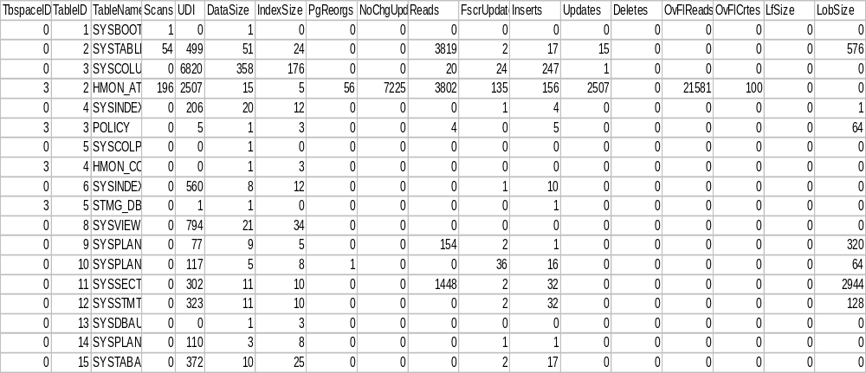
db2pd –db GTS1 -tcbstats Example
Notes:
NOTES: Use the db2pd –db <dbname> -tcbstats index command to identify key table and index data elements for tuning.
Key data elements are as follows:
NoChgUpdts -- the number of updates that did not change any columns in the table. Investigate SQL to eliminate unnecessary updates.
UDI – number of updates, inserts and deletes since RUNSTATS last run
OvFIReads – the number of overflow rows read from the table
OvFlCrtes – the number of new overflows that were created by such action as updates to varchar columns

Slide 39
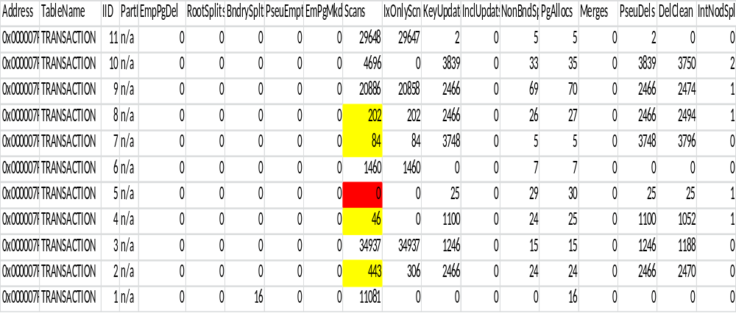
db2pd -db <dbname> -tcbstats index option
Command: db2pd –db GTS1 –tcbstats index
Notes:
NOTES:
Use values for Scans and IxOnlyScns columns to determine unused indexes. It is important to do this over a period of time and for all workloads to
preclude dropping used indexes.
RootSplits – The number of key insert or update operations that caused the index tree depth to increase. These should be avoided whenever possible due to overhead involved in a split.
KeyUpdates – The number of updates to the key. Key updates should be avoided due to overhead involved with maintaining the index and foreign keys. Updates to the key also violates rule that keys should be non-volatile.

Slide 40
Identify Unused Indexes using SYSCAT.INDEXES view
“db2 describe table syscat.indexes”
“select lastused,indname, tabname from syscat.indexes where lastused > ‘2012-01-01’” (note: Available in DB2 9.7 and above)
Great feature for identifying unused indexes for large applications like PeopleSoft and SAP
Review unused indexes with application developers and known weekly, monthly or yearly processes to prevent accidental drop of used index
But, by all means, get rid of unused indexes!
Notes:
NOTES: The LASTUSED column of SYSCAT.INDEXES is available in DB2 9.7 and above. Prior to that use db2pd –db <dbname> –tcbstats index option and subsequent analysis to identify and eliminate unused indexes. The lastused syscat.indexes column may not be updated immediately, it will be updated by background task or if you run runstats.

Slide 41
LASTUSED Column of SYSCAT.INDEXES 9.7 FP3a and below
Column does not reflect last used data correctly if indexes created in a different table space than table
Fix is to apply fix pack 4
  https://www-304.ibm.com/support/docview.wss?uid=swg1IC70265

Slide 42
DB2 9.7 New Time-spent Monitoring
New monitoring infrastructure and DB CFG parameters provide database-wide monitoring control
New relational monitoring functions are lightweight and SQL accessible
Information about work performed by applications is collected and reported through table function interfaces at three levels
  System level
    Details about worked performed on the system
    Service subclass, workload definition, uow and connection
  Activity level
    Details about a subset of work being performed on the system
  Data object level
    Details of work within specific objects
      Indexes, tables, bufferpools, tablespaces and containers
Notes:
NOTES:

Slide 43
Where is the time being spent?
Notes:
NOTES: You use time spent monitoring to visually depict where the time is spent in the database for a particular application or component and then use this information to drill-down to the problem.

Slide 44
Monitor Collection DB CFG Parameters
Mon_act_metrics – controls collection of activity level monitor elements on the entire database (DEFAULT – BASE)
  MON_GET_ACTIVITY_DETAILS
  MON_GET_PKG_CACHE_STMT
  Activity event monitor (DETAILS_XML monitor element in the event_activity logical data groups)
Mon_deadlock – controls generation of deadlock events on the entire database (DEFAULT- WITHOUT_HIST)
Mon_locktimeout – controls generation of lock timeout events on the entire database (DEFAULT – NONE)
Mon_lockwait – controls generation of lock wait events for the lock event monitor (DEFAULT – NONE)
Mon_lw_thresh – the amount of time spent in lock wait before an event for mon_lockwait is generated (DEFAULT - 5000000)
Mon_obj_metrics – controls collection of data object monitor elements on the entire database (DEFAULT- BASE)
  MON_GET_BUFFERPOOL
  MON_GET_TABLESPACE
  MON_GET_CONTAINER
Notes:
NOTES:

Slide 45
MON_GET_ACTIVITY_DETAILS
Use this table function to get similar data as that obtained from an application snapshot, plus much more detailed information not available in past releases
  Log_buffer_wait_times
  Num_log_buffer_full
  Log_disk_wait_time
  Log_disk_wait_time_total
  Lock_escals
  Lock_timeouts
In 9.7, activity metrics were stored in the DETAILS_XML column and had to be converted to a relational format by the XMLTABLE function
As of 9.7 FP4, activity metrics can now be collected in a table and queried with SQL directly
Notes:
NOTES:

Slide 46
Monitor Collection DB CFG Parameters
Mon_req_metrics – controls the collection of request monitor elements on the entire database (DEFAULT – BASE)
  MON_GET_UNIT_OF_WORK
  MON_GET_UNIT_OF_WORK_DETAILS
  MON_GET_CONNECTION
  MON_GET_CONNECTION_DETAILS
  MON_GET_SERVICE_SUBCLASS
  MON_GET_SERVICE_SUBCLASS_DETAILS
  MON_GET_WORKLOAD
  MON_GET_WORKLOAD_DETAILS
  Statistics event monitor (DETAILS_XML monitor element in the event_wlstats and event_scstats logical data groups)
  Unit of work event monitor
Mon_uow_data – controls the generation of UOW events at the database level for the UOW event monitor (DEFAULT – NONE)
Notes:
NOTES:

Slide 47
MON_GET_ACTIVITY_DETAILS Usage
Get the application handle, activity ID and UOW ID using the table function: wlm_get_workload_occurrence_activities_v97
"select application_handle, activity_id, uow_id, local_Start_time from table(wlm_get_workload_occurrence_activities_v97(Cast (null as bigint), -1) ) as t
APPLICATION_HANDLE ACTIVITY_ID UOW_ID LOCAL_START_TIME
-------------------- ----------- ----------- --------------------------
63595 1 28 2012-04-12-13.01.47.400679
1 record(s) selected.
Notes:
NOTES:

Slide 48
MON_GET_ACTIVITY_DETAILS cont.
SELECT actmetrics.application_handle,
actmetrics.activity_id,
actmetrics.uow_id,
varchar(actmetrics.stmt_text, 400) as stmt_text,
actmetrics.total_act_time,
actmetrics.total_act_wait_time,
CASE WHEN actmetrics.total_act_time > 0
THEN DEC((
FLOAT(actmetrics.total_act_wait_time) /
FLOAT(actmetrics.total_act_time)) * 100, 5, 2)
ELSE NULL
END AS PERCENTAGE_WAIT_TIME
FROM TABLE(MON_GET_ACTIVITY_DETAILS(63595, 28, 1, -2)) AS ACTDETAILS,
XMLTABLE (XMLNAMESPACES( DEFAULT 'http://www.ibm.com/xmlns/prod/db2/mon'),
'$actmetrics/db2_activity_details'
PASSING XMLPARSE(DOCUMENT ACTDETAILS.DETAILS) as "actmetrics"
COLUMNS "APPLICATION_HANDLE" INTEGER PATH 'application_handle',
"ACTIVITY_ID" INTEGER PATH 'activity_id',
"UOW_ID" INTEGER PATH 'uow_id',
"STMT_TEXT" VARCHAR(1024) PATH 'stmt_text',
"TOTAL_ACT_TIME" INTEGER PATH 'activity_metrics/total_act_time',
"TOTAL_ACT_WAIT_TIME" INTEGER PATH 'activity_metrics/total_act_wait_time'
) AS ACTMETRICS;
Notes:
NOTES: Use the application handle, activity ID and UOW ID as input to the mon_get_activity_details function. In 9.7, activity metrics were stored in the DETAILS_XML column and had to be converted to a relational format by the XMLTABLE function
As of 9.7 FP4, activity metrics can now be collected in a table and queried with SQL directly.

Slide 49
DB2 10 Event Monitor Enhancements
All event monitors support write-to-table format
Can be altered to capture additional logical data groups
Can be upgraded from previous releases
  EVMON_UPGRADE_TABLES stored procedure
New Change History event monitor
  Tracks DDL, Configuration, Registry and Utilities
Pruning of data from Unformatted Event Monitor tables
  Use PRUNE_UE_TABLES option of the EVMON_FORMAT_UE_TO_TABLES stored procedure
New DB2 10 Usage List object
Notes:
NOTES:

Slide 50
Philip K. Gunning
Gunning Technology Solutions, LLC pgunning@gts1consulting.com
Session C2
Title: Tuning Tips for DB2 LUW in an OLTP Environment

